Slide 1

Maths 11
Integration mk2

Slide 2
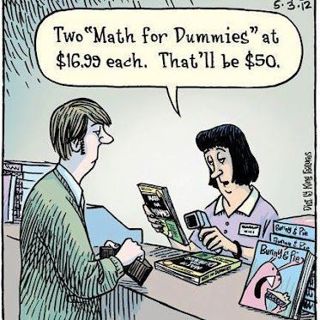
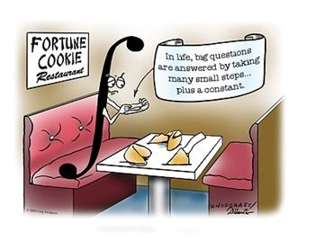
Integration 2
I’m running out of relevant comics!

Slide 3
Integration 2
In some previous examples we covered the integrals of cos and sin but let’s look at them formally.
Remember integration is just the reverse of derivation.
The same applies to trigonometric functions.

Slide 4
Integration 2
If we remember the derivatives of sin cos and tan are cos –sin and sec²

Slide 5

Integration 2
If we remember the derivatives of sin cos and tan are cos –sin and sec²
So:
$$\int{\cos\left(x\right)dx}$$

Slide 6

Integration 2
If we remember the derivatives of sin cos and tan are cos –sin and sec²
So:
$$\int{\cos\left(x\right)dx}=\sin\left(x\right)+C$$

Slide 7

Integration 2
If we remember the derivatives of sin cos and tan are cos –sin and sec²
So:
$$\int{\sin\left(x\right)dx}=−\cos\left(x\right)+C$$

Slide 8

Integration 2
If we remember the derivatives of sin cos and tan are cos –sin and sec²
So:
$$\int{\sec^{2}{(x)}dx}=\tan\left(x\right)+C$$

Slide 9

Integration 2
These are the basic 3 rules after these it gets a bit complicated:
$$\int{\tan{(ax)}dx}= \frac{1}{a}\ln\left|\cos\left(ax\right)\right|+C$$

Slide 10
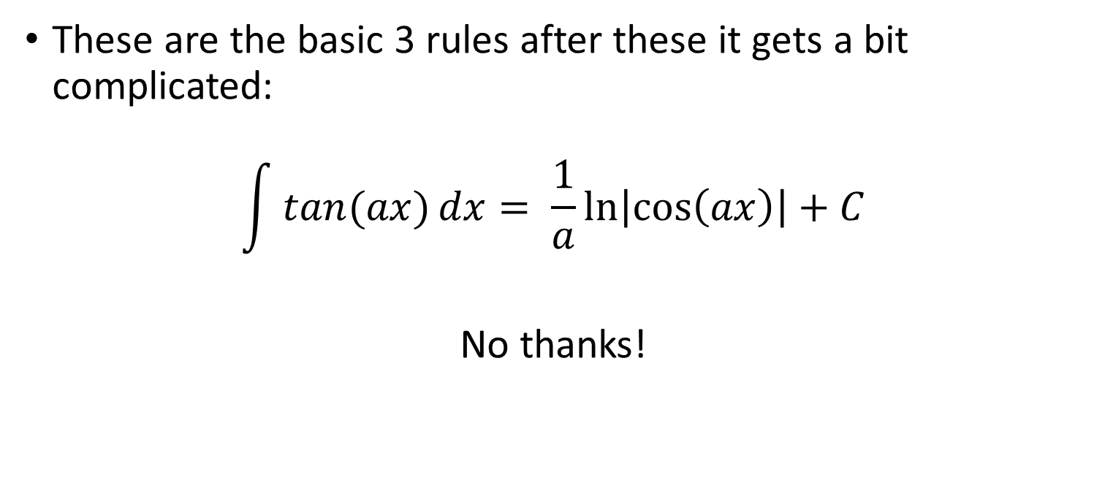
Integration 2
These are the basic 3 rules after these it gets a bit complicated:
$$\int{\tan{(ax)}dx}= \frac{1}{a}\ln\left|\cos\left(ax\right)\right|+C$$
No thanks!

Slide 11
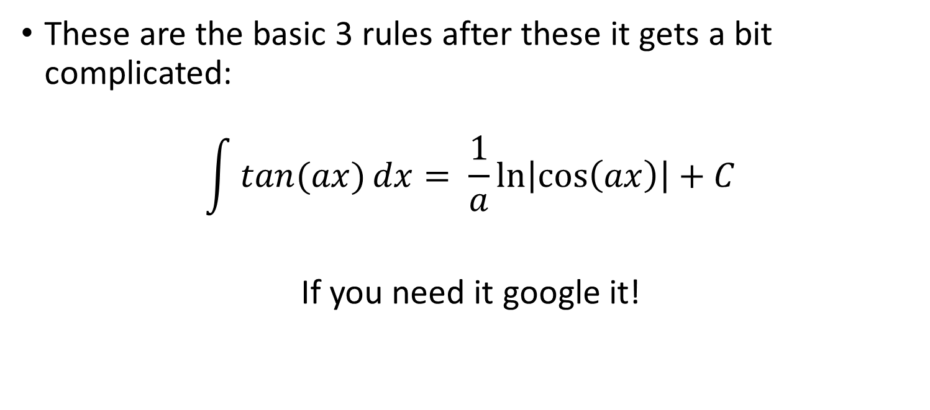
Integration 2
These are the basic 3 rules after these it gets a bit complicated:
$$\int{\tan{(ax)}dx}= \frac{1}{a}\ln\left|\cos\left(ax\right)\right|+C$$
If you need it google it!

Slide 12
Integration applications
We have seen how we can use differentiation to estimate growth, and see how an exponent effects a function.
What this comes down to is whether a function is increasing or decreasing proportionally to the value of the function.

Slide 13
Integration applications
Exponential growth is fairly common in scientific uses.
Let’s think about a bacteria.

Slide 14
Integration applications
Exponential growth is fairly common in scientific uses.
Let’s think about a bacteria.
A bacteria splits into 2 every 6 hours.

Slide 15
Integration applications
Exponential growth is fairly common in scientific uses.
Let’s think about a bacteria.
A bacteria splits into 2 every 6 hours.
At the start we have a single bacteria

Slide 16
Integration applications
At the start we have a single bacteria.
After 6 hours we have 2.
After another 6 hours those 2 split into 4.
Another 6 and we have 8.

Slide 17
Integration applications
At the start we have a single bacteria.
After 6 hours we have 2.
After another 6 hours those 2 split into 4.
Another 6 and we have 8.
Another 6 and we have 16.

Slide 18
Integration applications
A single bacteria in a day turned into 16. This seems like a slow growth rate. But what about 20 days?
We would have 1,208,925,819,614,629,174,706,176 bacteria or 1.21 x10²⁴
Which is about the same amount of bacteria as there are stars in the universe.

Slide 19
Integration applications
How about decay? What happens if something decreasing proportionally to how much there is?
This is most commonly thought of in terms of radioactive elements.
If we have a radioactive substance that decays we measure this in half life.

Slide 20
Integration applications
Half life is how long it takes for half the atoms to decay. (we just saw the opposite of this, the doubling time).
If we have a radioactive isotope with a half life of 6 hours then it takes 6 hours for half the atoms to decay.
So if we had 1.21x10²⁴ atoms it would take 20 days for it all to decay away at a half life of 6 hours. (Reverse of our bacteria)

Slide 21
Integration applications
These principals are what come under the law of exponential growth or decay.
This is written in the formula y = y₀e^{kt} where the value of y is equal to the starting value of y times e to the power of a constant k times the time step.
This is just the same as our y = a^{bx} standard exponential equation.

Slide 22
Integration applications
The constant k is often provided when thinking about doubling times or half lifes but in reality is just the rate of change or the differential
If we have an element that is decaying at a rate proportional to the quantity of the element where the change between steps is -1/40.

Slide 23
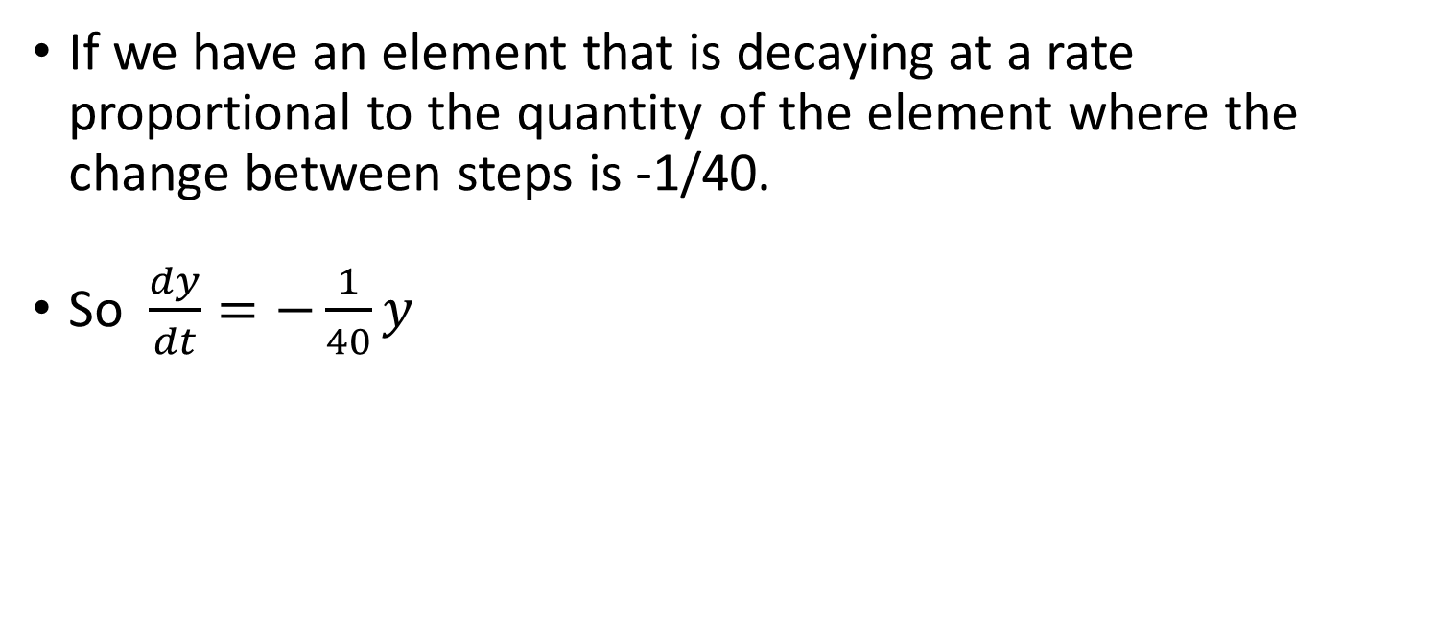
Integration applications
If we have an element that is decaying at a rate proportional to the quantity of the element where the change between steps is -1/40.
So $\frac{dy}{dt}=−\frac{1}{40}y$

Slide 24
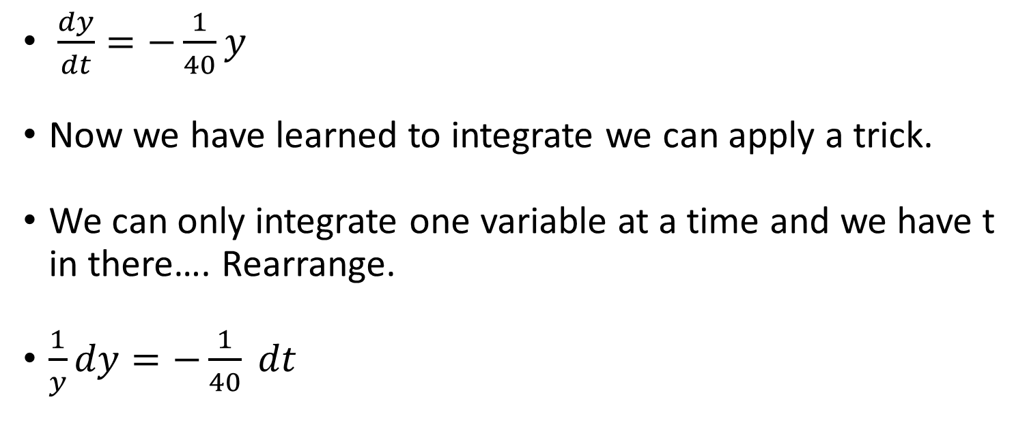
Integration applications
$\frac{dy}{dt}=−\frac{1}{40}y$
Now we have learned to integrate we can apply a trick.
We can only integrate one variable at a time and we have t in there…. Rearrange.
$\frac{1}{y}dy=−\frac{1}{40} dt$

Slide 25

Integration applications
$\frac{dy}{dt}=−\frac{1}{40}y$
$\frac{1}{y}dy=−\frac{1}{40} dt$
Now we can integrate
$\int{\frac{1}{y}dy}=−\int{\frac{1}{40} dt}$

Slide 26

Integration applications
$\frac{dy}{dt}=−\frac{1}{40}y$
$\int{\frac{1}{y}dy}=−\int{\frac{1}{40} dt}$
$\ln\left|y\right|=−\frac{1}{40}t+C$

Slide 27

Integration applications
$\frac{dy}{dt}=−\frac{1}{40}y$
$\ln\left|y\right|=−\frac{1}{40}t+C$
Now we want to rearrange it in terms of y
$e^ln\left|y\right|=e^−\frac{1}{40}t+C$

Slide 28

Integration applications
$\frac{dy}{dt}=−\frac{1}{40}y$
$\ln\left|y\right|=−\frac{1}{40}t+C$
$y= e^{−40t+C}$

Slide 29

Integration applications
$\frac{dy}{dt}=−\frac{1}{40}y$
$\ln\left|y\right|=−\frac{1}{40}t+C$
$y= e^{−40t+C}$ because of how exponents work…
$y=Ce^{−40t}$

Slide 30

Integration applications
$\frac{dy}{dt}=−\frac{1}{40}y$
$\ln\left|y\right|=−\frac{1}{40}t+C$
$y=Ce^{−40t}$ if that constant is the initial value of y
$y=y_{0}e^{−40t}$

Slide 31
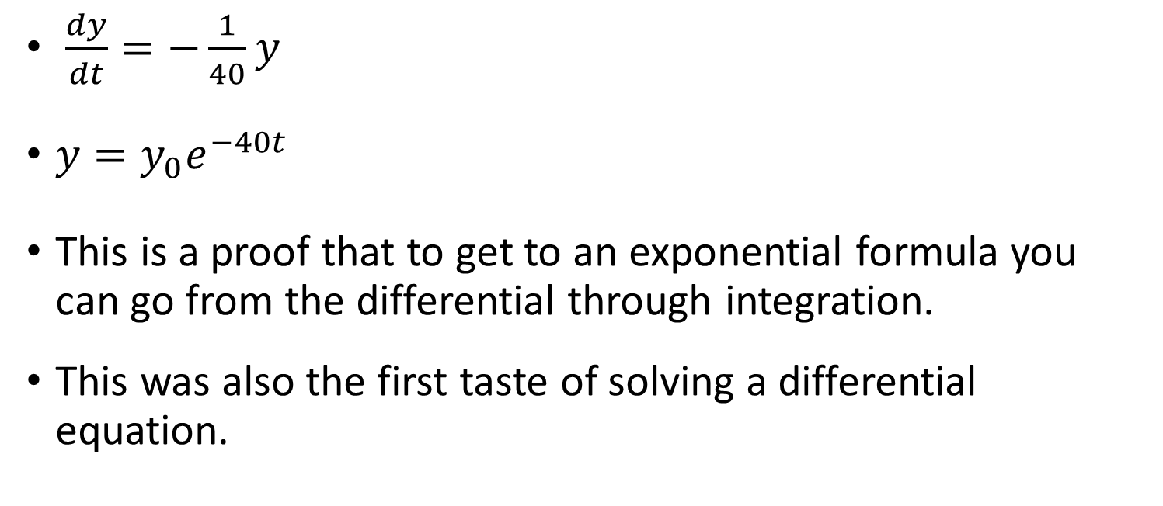
Integration applications
$\frac{dy}{dt}=−\frac{1}{40}y$
$y=y_{0}e^{−40t}$
This is a proof that to get to an exponential formula you can go from the differential through integration.
This was also the first taste of solving a differential equation.

Slide 32
Integration applications
If we want to estimate the growth rate of a population we can use this formula.
y = y₀e^{kt}
Say we have a bacteria that increases started with 50 cells and is at 3000 cells 5 hours later.

Slide 33
Integration applications
y = y₀e^{kt}
Say we have a bacteria that increases started with 50 cells and is at 3000 cells 5 hours later.
3000 = 500e^{k5}

Slide 34
Integration applications
y = y₀e^{kt}
Say we have a bacteria that increases started with 50 cells and is at 3000 cells 5 hours later.
3000 = 500e^{k5}
3000/500 = 500e^{k5} / 500

Slide 35
Integration applications
y = y₀e^{kt}
Say we have a bacteria that increases started with 50 cells and is at 3000 cells 5 hours later.
6 = e^{k5}

Slide 36
Integration applications
y = y₀e^{kt}
Say we have a bacteria that increases started with 50 cells and is at 3000 cells 5 hours later.
Ln(6 )= ln(e^{k5} )

Slide 37
Integration applications
y = y₀e^{kt}
Say we have a bacteria that increases started with 50 cells and is at 3000 cells 5 hours later.
Ln(6 )= 5k

Slide 38
Integration applications
y = y₀e^{kt}
Say we have a bacteria that increases started with 50 cells and is at 3000 cells 5 hours later.
k = ln(6)/5 = 0.36

Slide 39
Integration applications
y = y₀e^{kt}
Say we have a bacteria that increases started with 50 cells and is at 3000 cells 5 hours later.
k = ln(6)/5 = 0.36
Or in essence an increase of 36% per hour.

